Slide 1
Stimulating neural network in brain with LIF model
Group1
Yanqing Cai, Jinyi Lai, Delin Chen, Guoshun He, Mengjiao Li, Wanting Xu, Jiayu Wang(In no particular order)

Slide 2
Outline
1.backgrounds
2.single LIF neuron with only excitatory input
3.introduction of inhibitory neurons
4.network building
5.extension: diseases solved by neuroscience

Slide 3
What kind of biological process does our model simulate?
What kind of problem to solve?

Slide 4
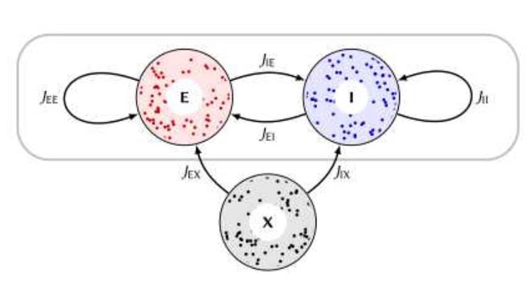
backgrounds

Slide 5
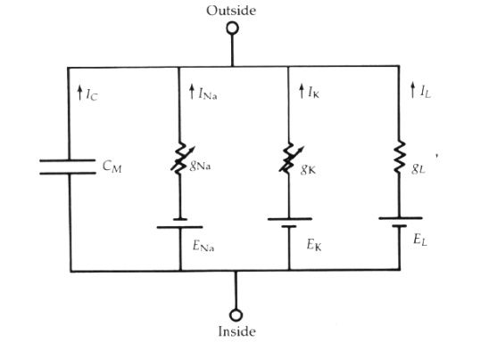

Slide 6
2.single LIF neuron with only excitatory input

Slide 7
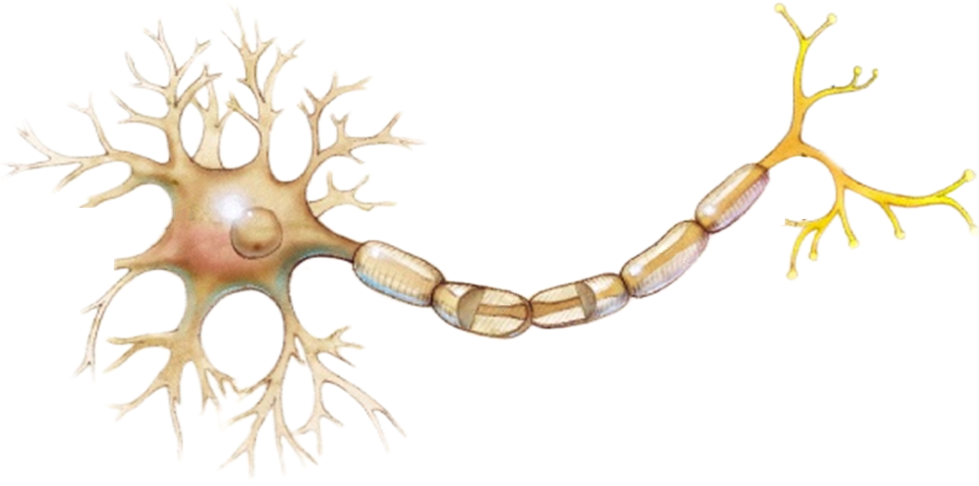
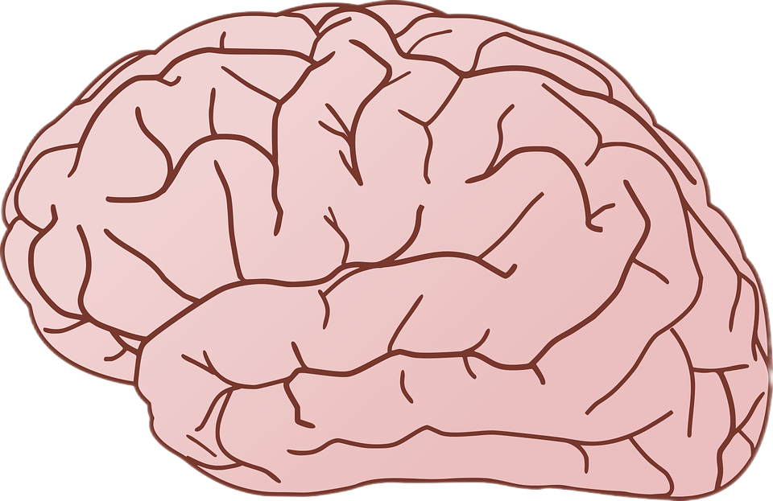


single LIF neuron with only excitatory input

Slide 8

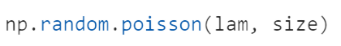
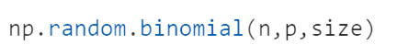
generating spike trains
irregular and asynchronous input

Slide 9
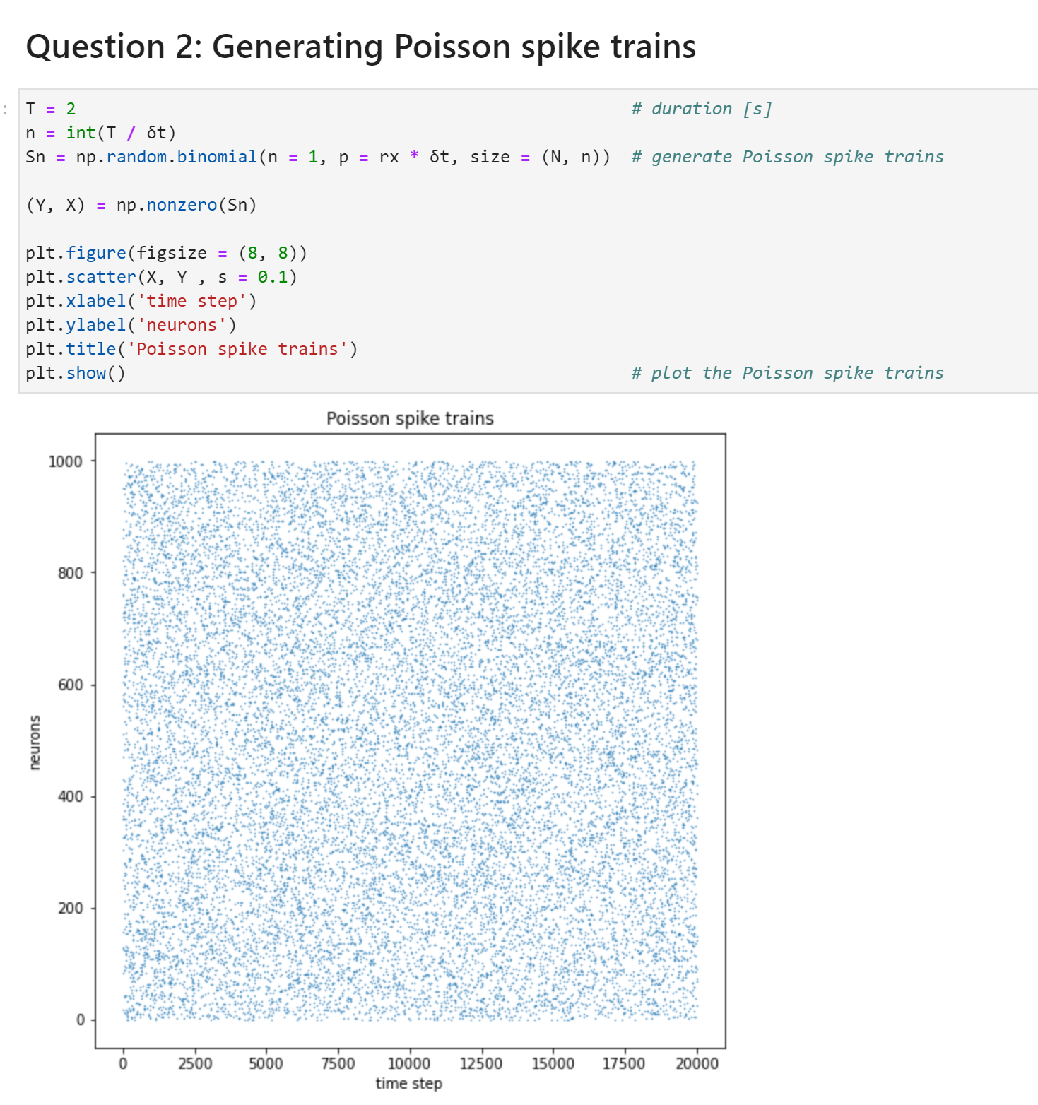
generating spike trains
neurons
time step

Slide 10
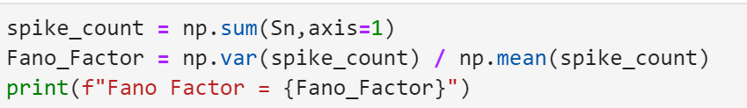
generating spike trains
the Fano factor is around 1
irregular

Slide 11
generating spike trains
asynchronous

Slide 12
LIF neuron with one input spike train
1.generate a Poisson input
2.inject the input into the neuron
3.plot the result

Slide 13
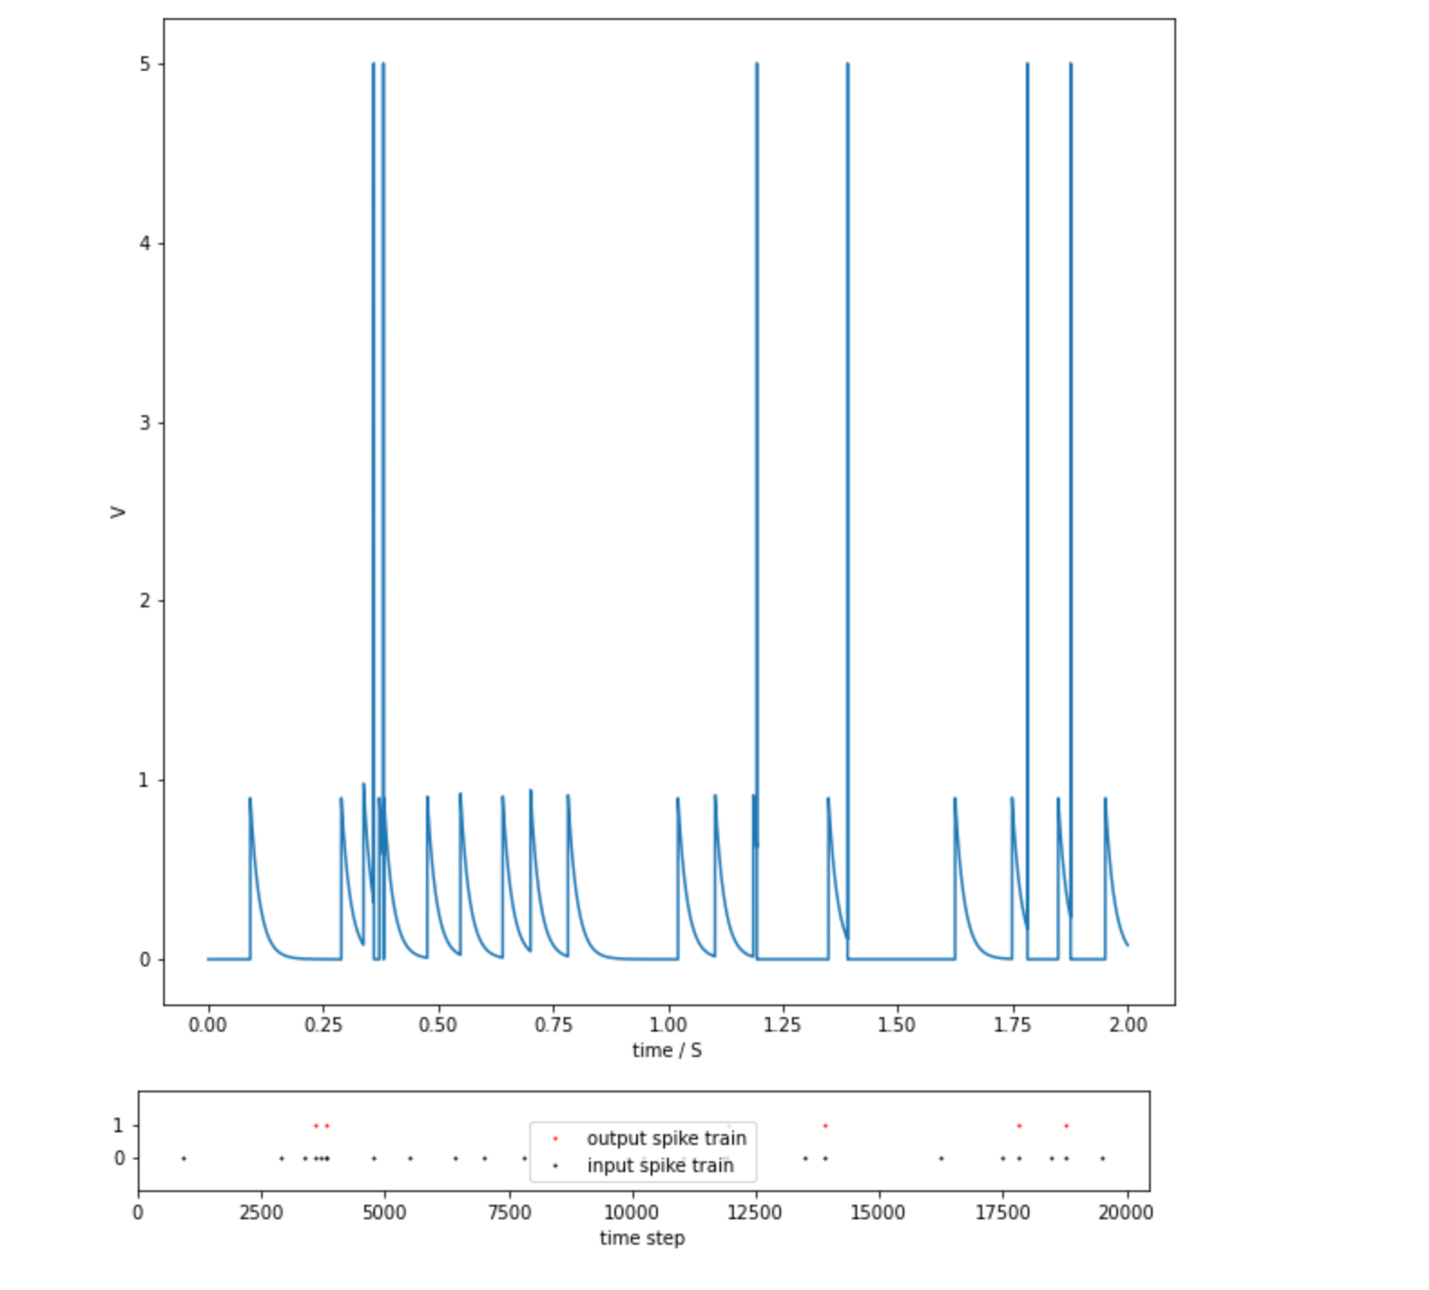
LIF neuron with one input spike train

Slide 14
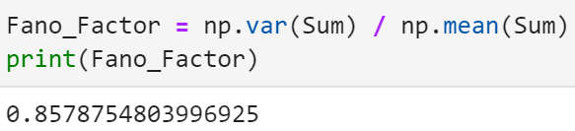
LIF neuron with one input spike train
irregular but not as irregular as the input

Slide 15
LIF neuron with many input spike trains
How to find w?
1.Disable the spike-and-resetmechanism, and find the relationship between μ and w
2.Find a suitable weight which could enable μ equal to V_{th}
3.Find a suitable weight which could make the output firing rate equal to 10Hz

Slide 16
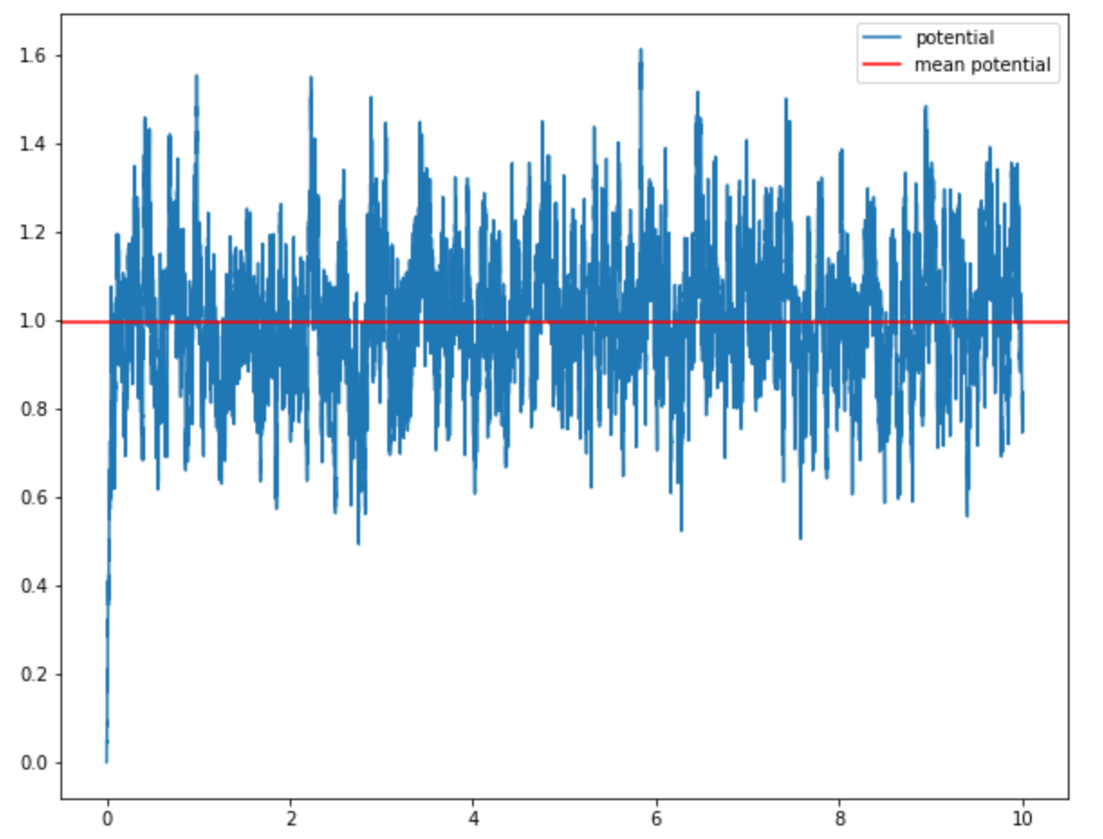

LIF neuron with many input spike trains
W = 5
potential
mean potential
make the mean potential be equal to one
Time/S

Slide 17
LIF neuron with many input spike trains
Disable the spike-and-resetmechanism, and find the relationship between μ and w
Find a suitable weight which could enable μ equal to V_{th}
Find a suitable weight which could make the output firing rate equal to 10Hz

Slide 18
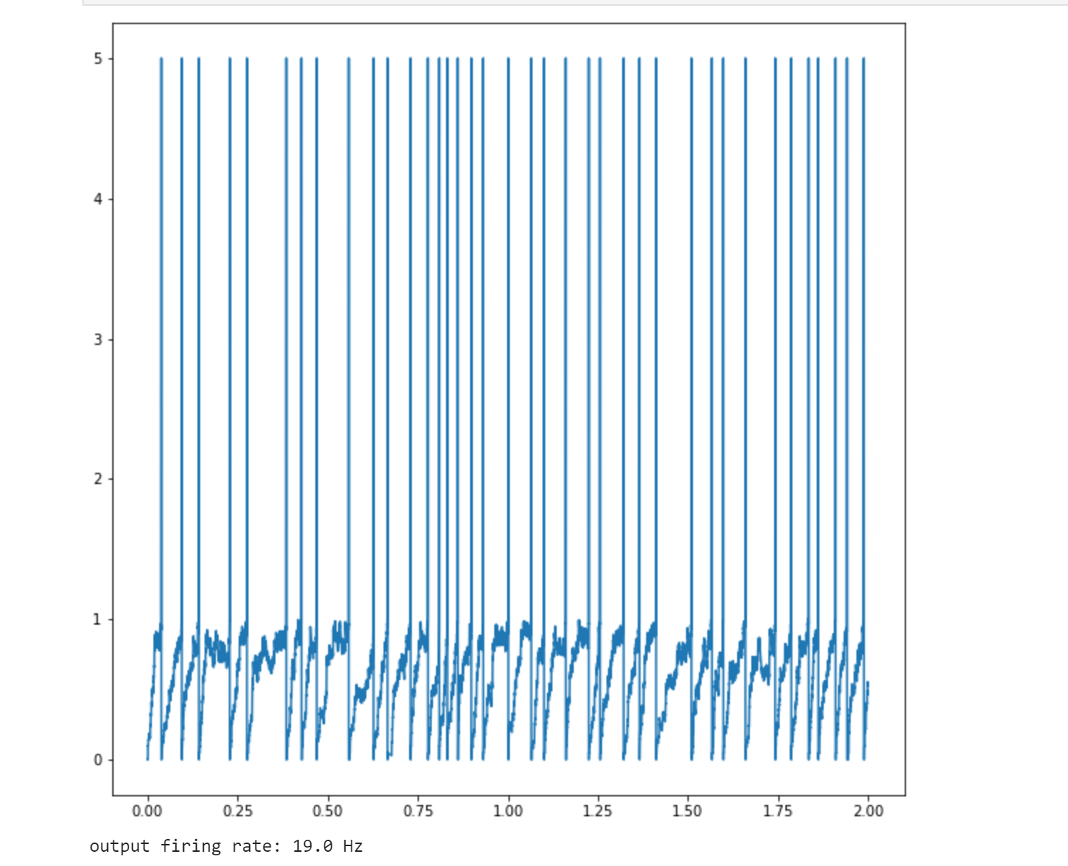
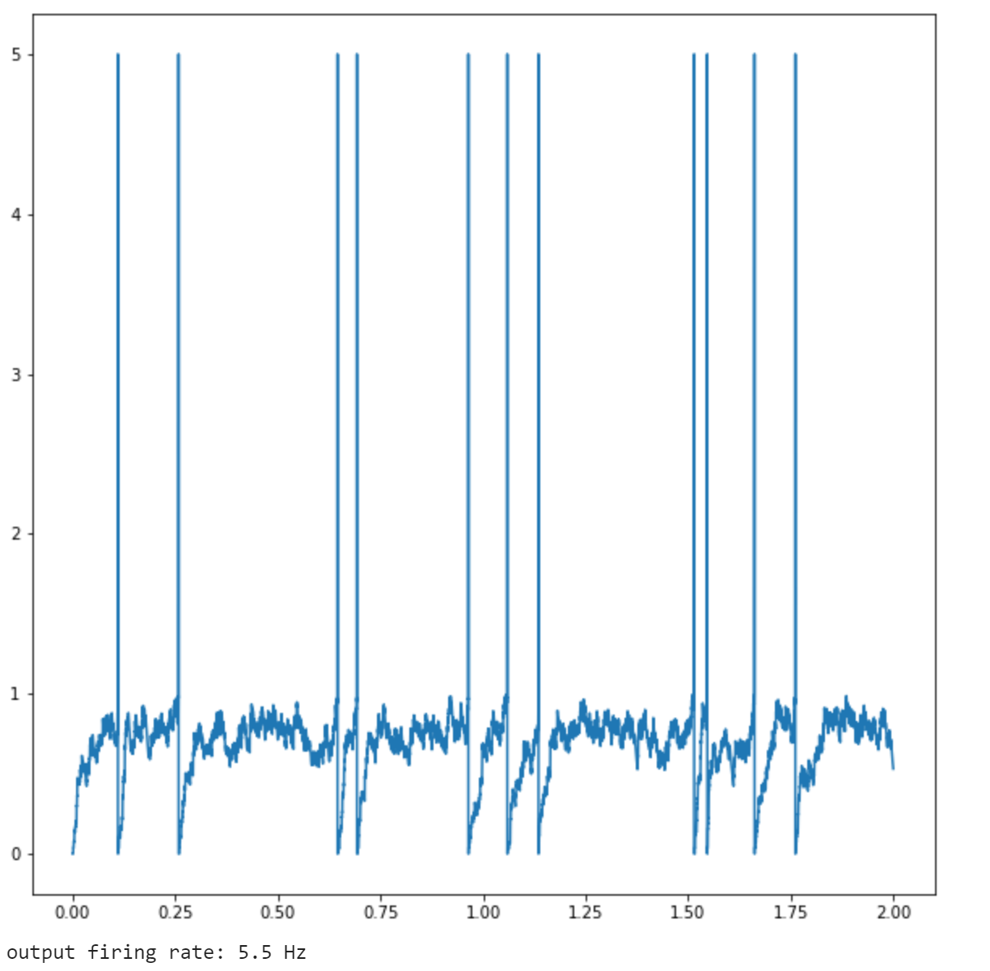
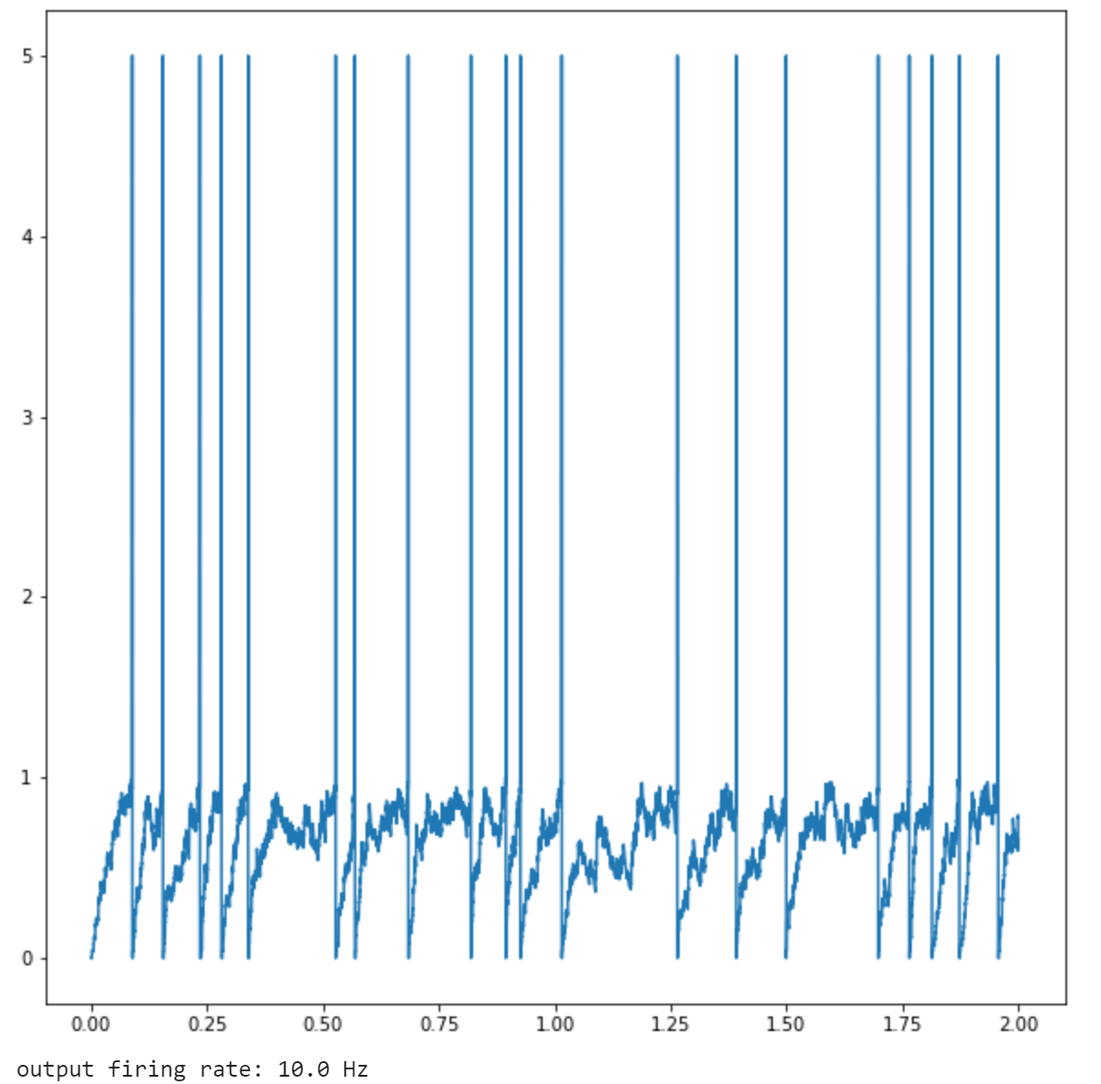
LIF neuron with many input spike trains
W = 5
W = 4
W = 4.27
output firing rate：
19.0 Hz 5.5 Hz 10.0Hz

Slide 19
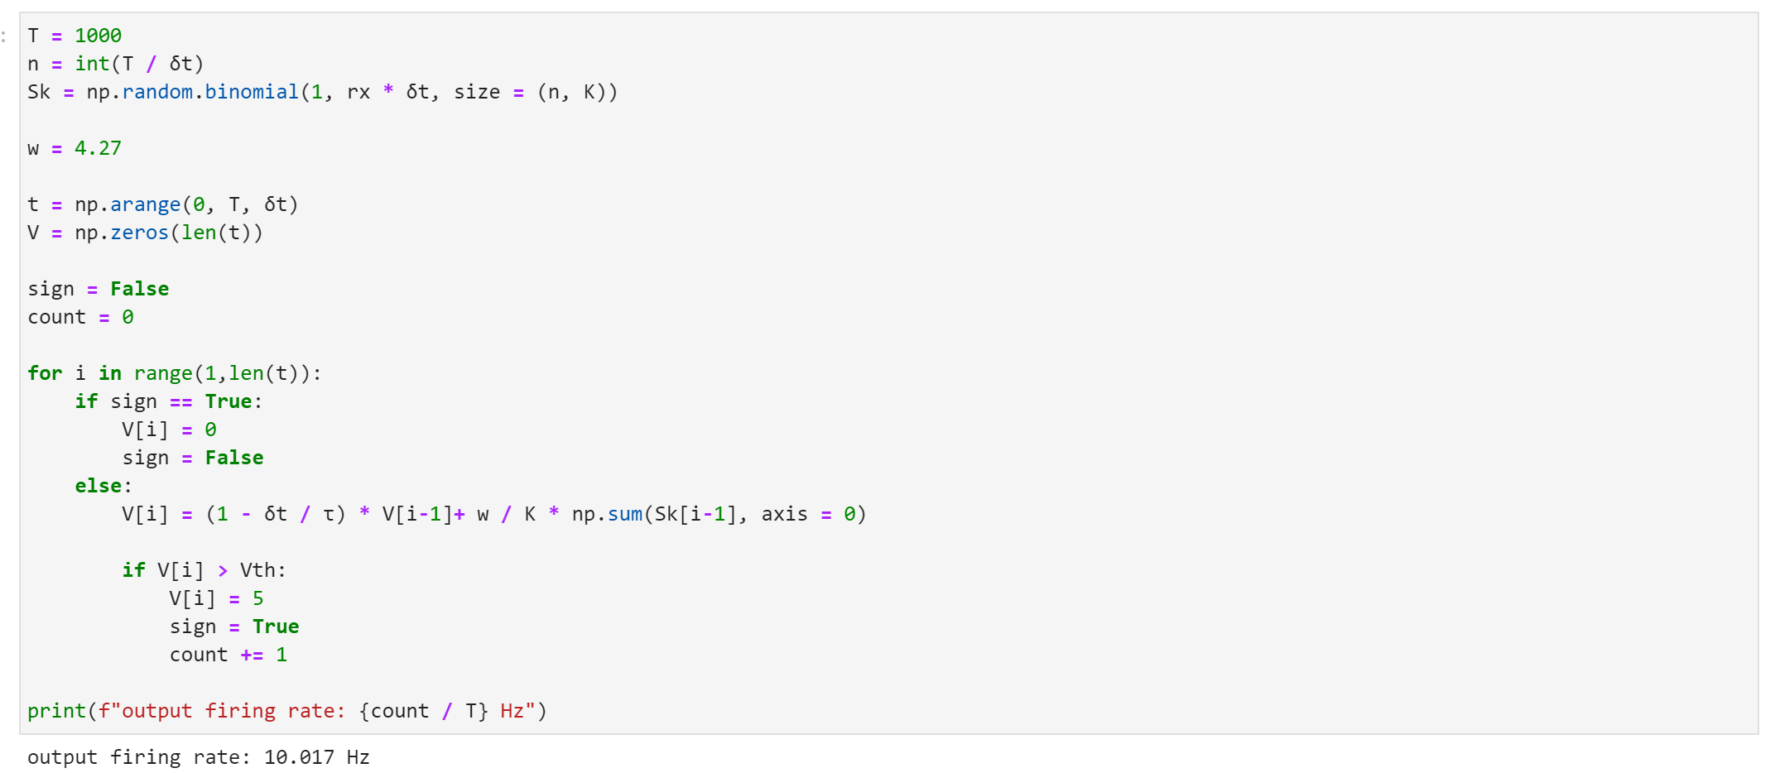
LIF neuron with many input spike trains
W = 4.27
prolonged duration
(1000 second)
4.27 is suitable

Slide 20
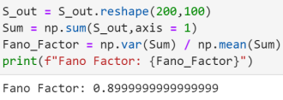

LIF neuron with many input spike trains
more irregular than the output of LIF neuron with one input
less irregular than Poisson process

Slide 21
3.introduction of inhibitory neurons

Slide 22
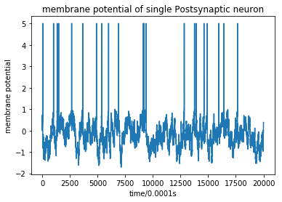
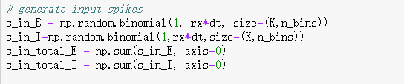
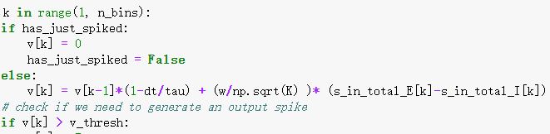
LIF neurons with E/I inputs codes & result

Slide 23
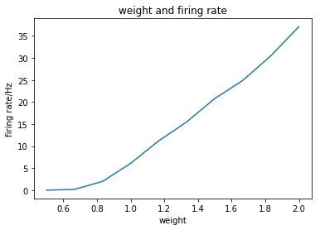
LIF neurons with E/I inputs weight and firing rate
weight≈1.2 when firing rate=10Hz
Almost linear

Slide 24
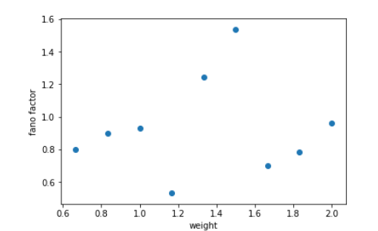
LIF neurons with E/I inputs weight and fano factors

Slide 25
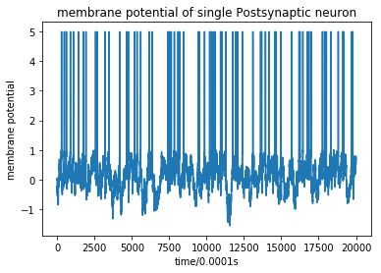
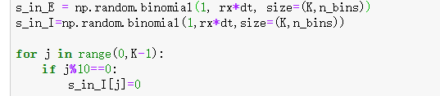
LIF neurons with E/I inputs higher E/I ratio
1/10 of inhibitory neurons are zeroed out
More action potentials are produced

Slide 26
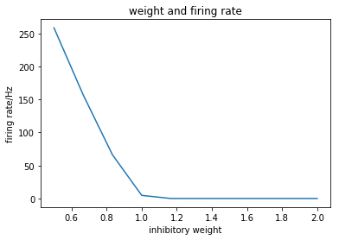
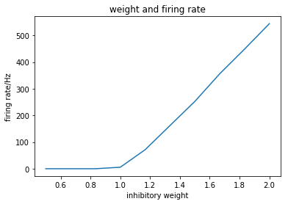
Influence of Weight of I and E

Slide 27
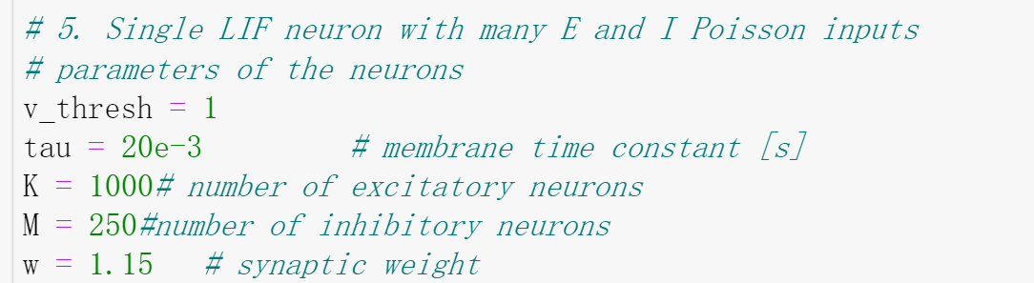
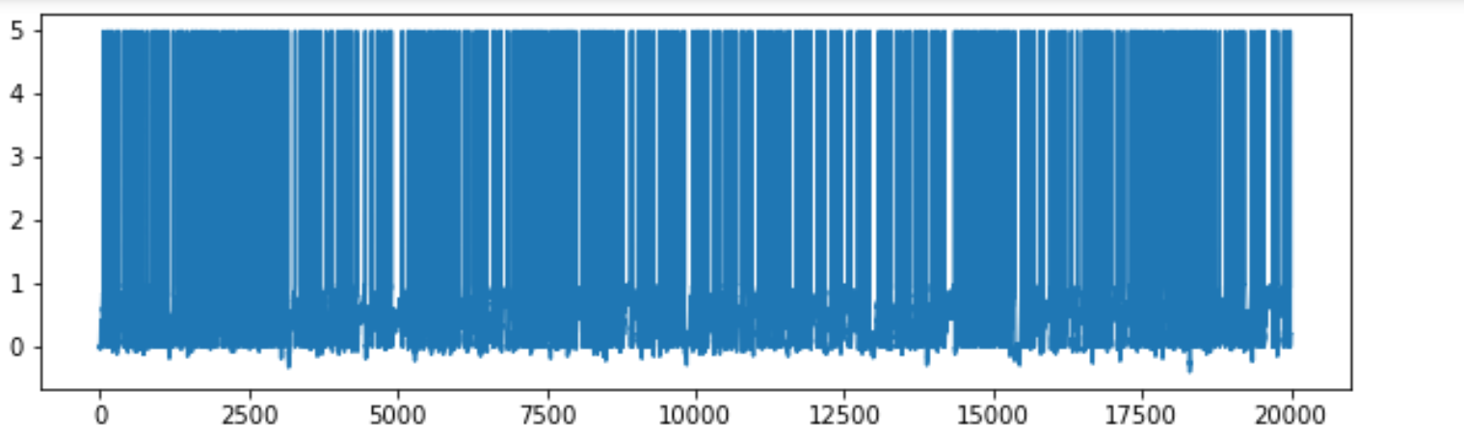
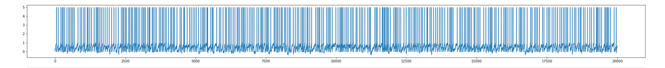
stimulate the real situation in our brain

Slide 28
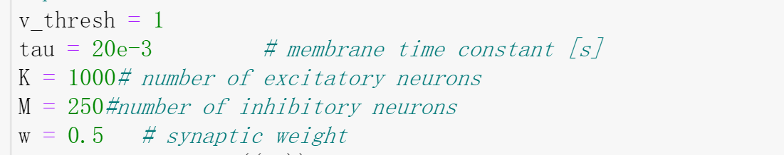
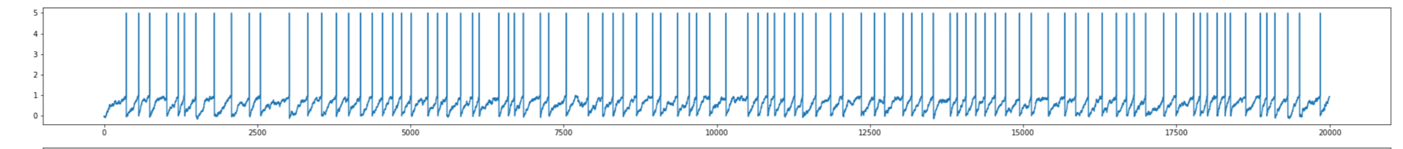
First way

Slide 29
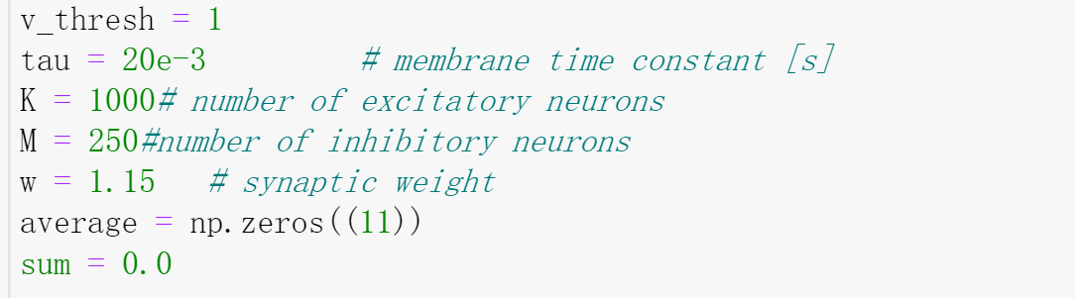
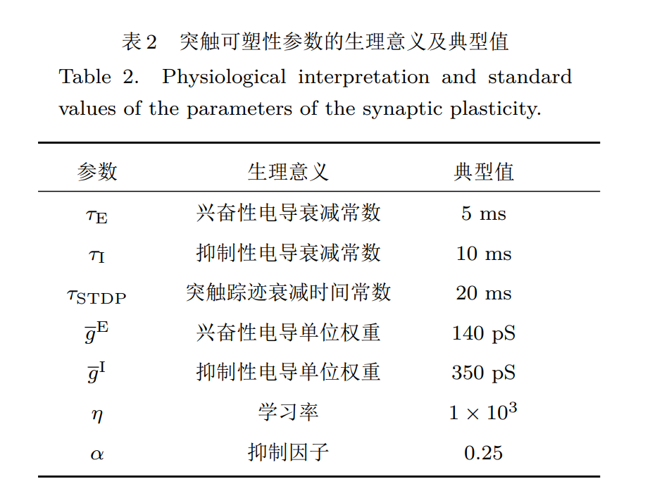
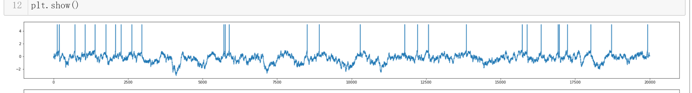
Second way

Slide 30
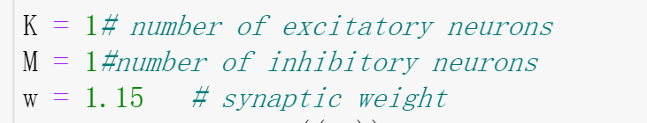
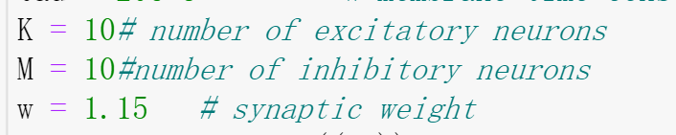
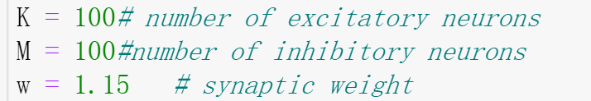
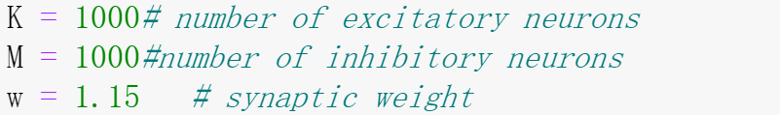
What is the influence of synapse number?

Slide 31
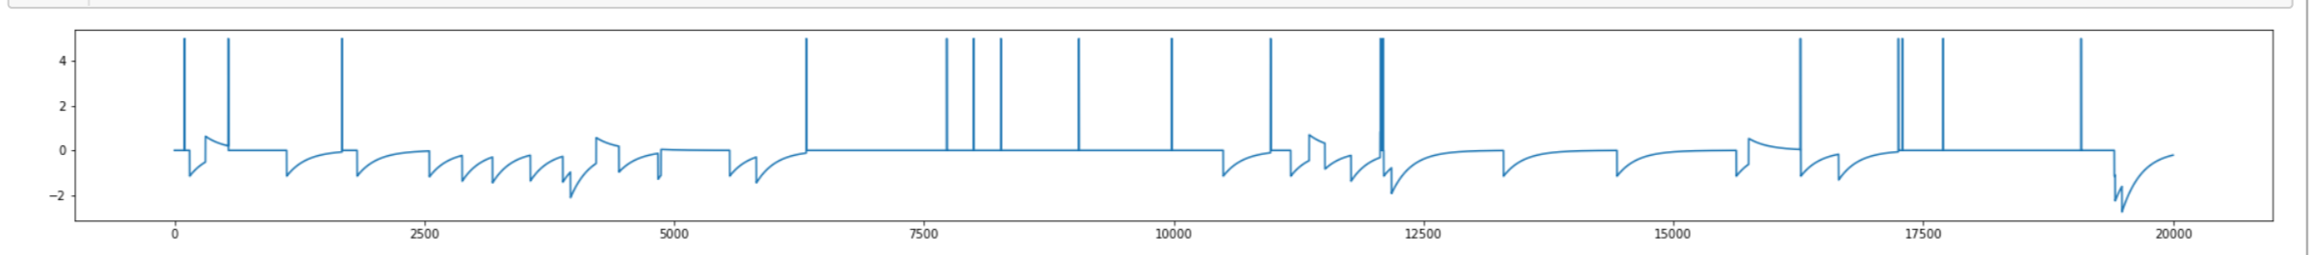
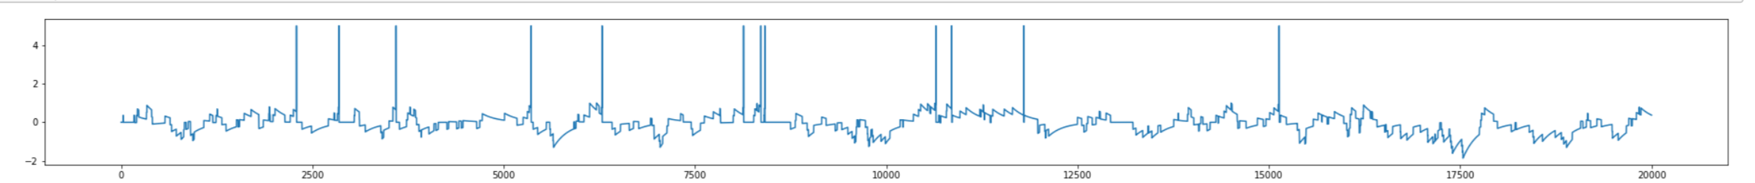
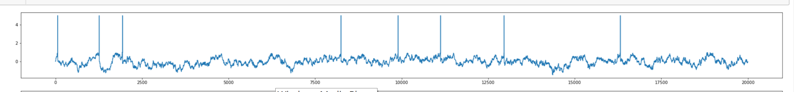
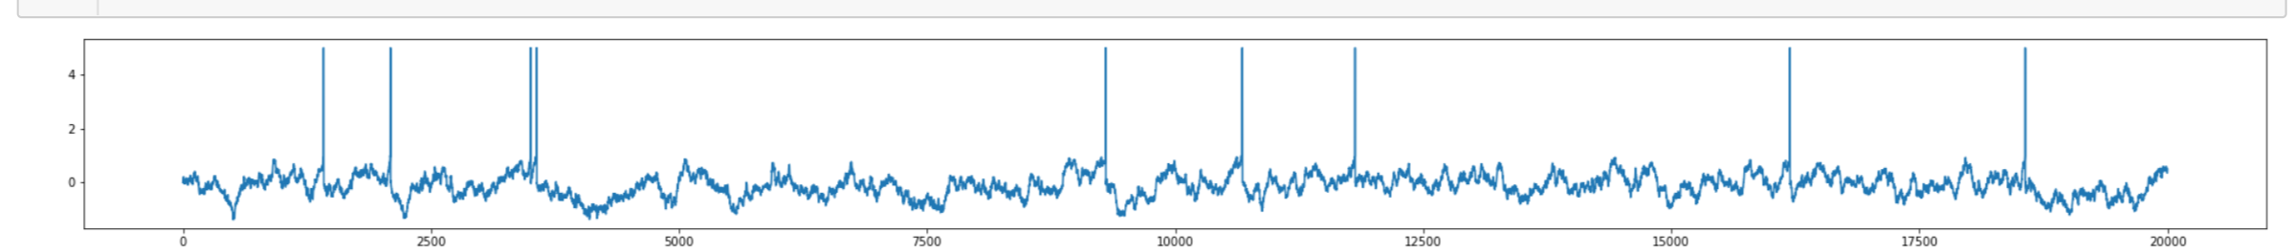
The more synpases a neuron has,
The more relatively stable
the excitatory and inhibitory synaptic balance is.

Slide 32
4.network building

Slide 33
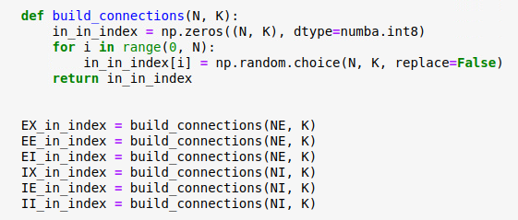
network building codes
Most of the work is the same as the previous work, so I'll just talk about the differences
Use np.random.choice () to build connections.

Slide 34
network building codes
Be aware that the connections of each type should be different.
don’t use np.random.bionomial() here
different

Slide 35
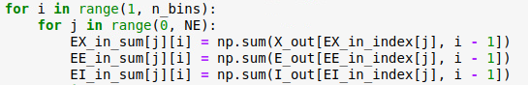
network building codes
The way to sum the input.

Slide 36
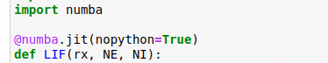
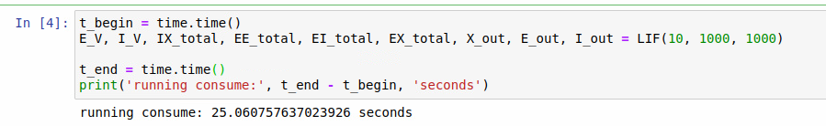
network building codes
numba = rocket
(it’s so powerful! ＞▽＜)

Slide 37
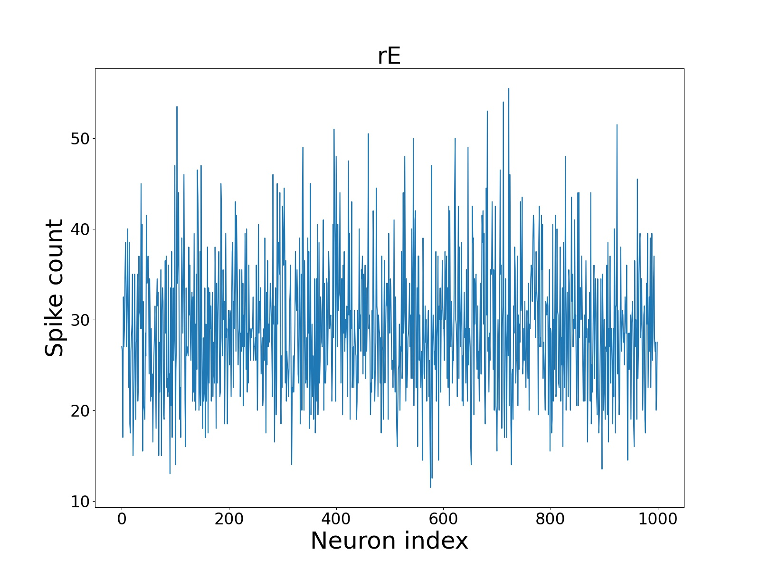
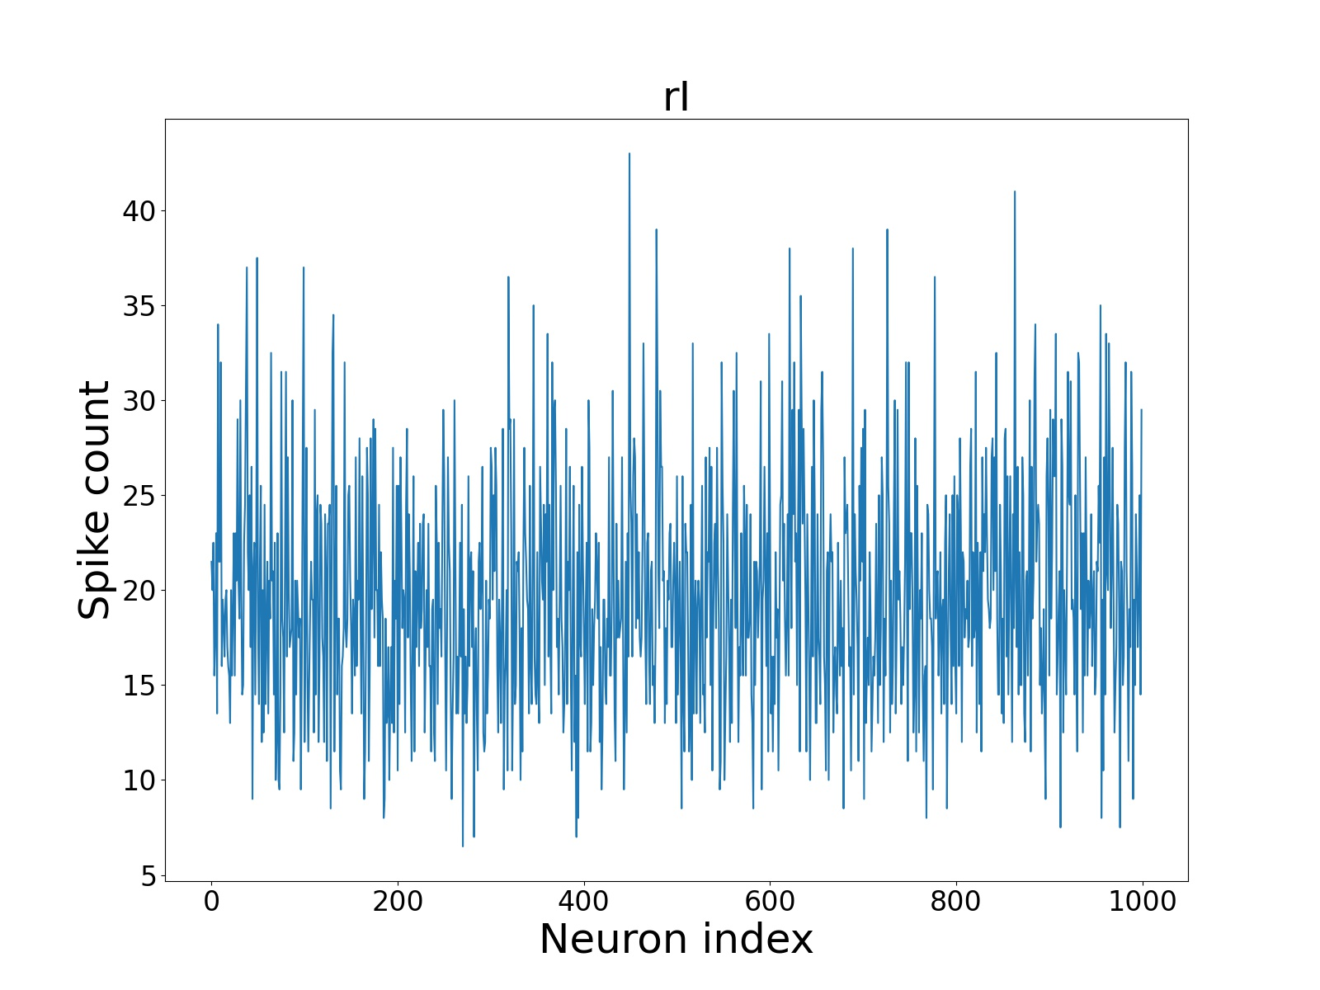
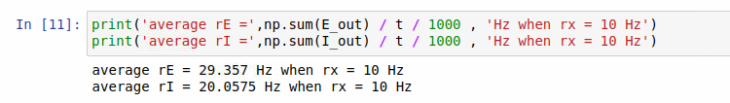
network building E/I neurons and their firing rates

Slide 38
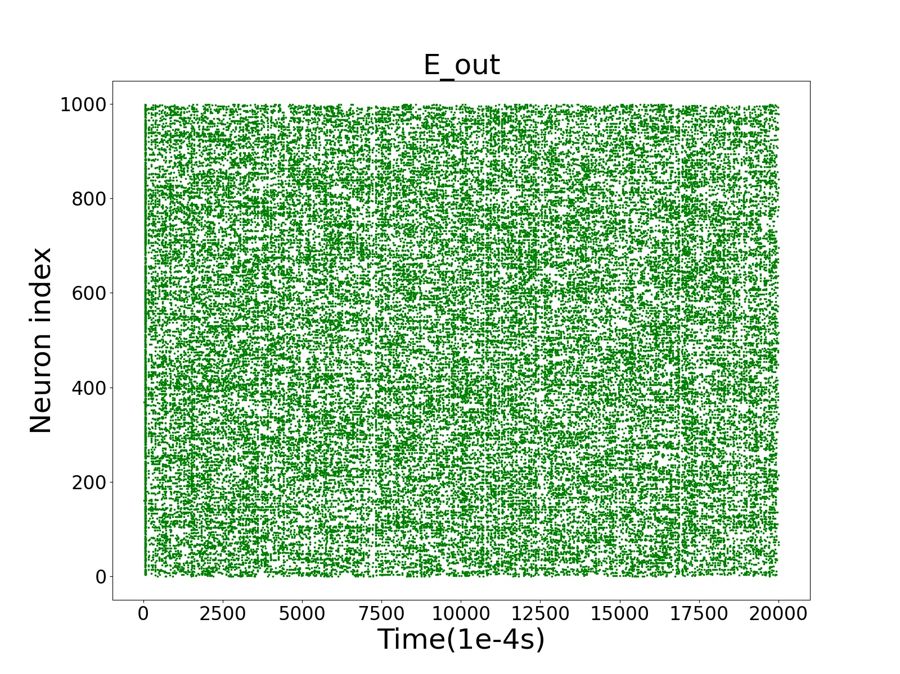
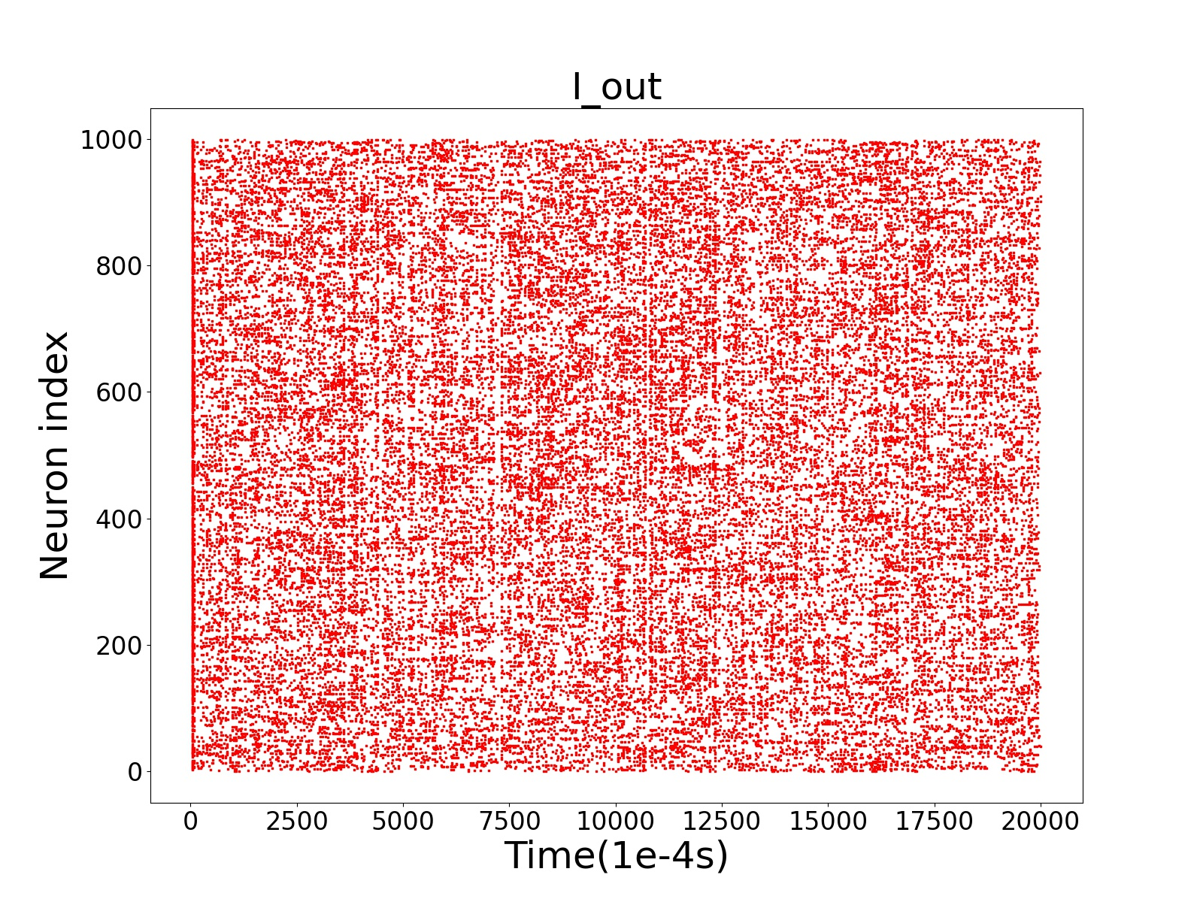

network building E/I neurons and their scatter plots
The outputs of type E neurons is denser than that of type I neurons, which in turn is denser than that of type X neurons.

Slide 39

network building voltage of single neuron
Its voltage curve shows no difference from that in question 5.

Slide 40


network building voltage of many neurons
asynchronous, random

Slide 41


Why do these curves jump at the same time ?

Slide 42

Why do these curves jump at the same time ?
When all the neurons are at their resting potential. one become active ,causes others active -> chain reaction
If triggered active E neurons are more then active I neurons (or fast) -> jump.
opposite -> calm.

Slide 43

About 6.3
If you average multiple summations, you will get a smoother curve.

Slide 44



network building using different method to connect
Voltage of the first 10 excitatory neurons in 2 seconds
Old Version : Use Gaussian distribution instead of random sampling
Voltage of the first 10 inhibitory neurons in 2 seconds
Old Version : Computational efficiency is low

Slide 45


NEXT what about relations between firing rate and weight

Slide 46

When the weight of inhibition signals ges close to 0,
the firing rate will suddenly increase.
Although influence of the excitatory neuron’s weight is relatively weak, there is still a tendency to increase as it grows.
J_II J_EI
J_EE J_IE

Slide 47






magnification
magnification

Slide 48



Become extremely large and abnormal
Suitable weight of the synaptic coupling means a lot to human’s brain,
either imbalance can lead to disease.

Slide 49
5. extension: diseases solved by neuroscience

Slide 50

TVB: The virtual brain
A model in neuroscience to show the disease progression in our brain
A brain map

Slide 51
Examples of tvb
Epilepsy: the synchronicity of the excitatory and inhibitory nerves
Stroke: associated with the hyper-excitability

Slide 52



Slide 53
E/I ratio
Gene expression
Disorder
neuronal activity

Slide 54
Thanks for listening

